Slide 1
GPRA
Government Performance and Results Act
Mary Brickell, IT Specialist, GPRA Coordinator
Portland Area Indian Health Service
March 2012

Slide 2
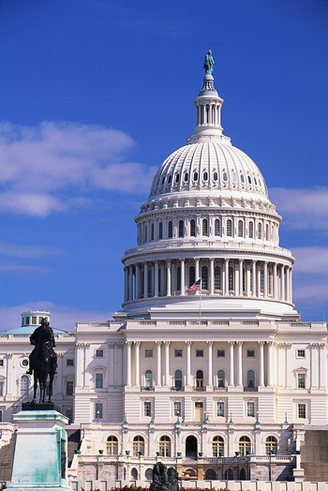
GPRA is a Federal Law
Government Performance and Results Act of 1993
  Requires Federal agencies to demonstrate that they are using their funds effectively toward meeting their missions.

Slide 3


Requires a data-supported audit trail from appropriated dollars to activities and ultimately to customer benefits or outcomes consistent with an agency’s mission
$ Dollars $
(Budget
Appropriations)
The
Audit Trail
Agency
Mission
Health Benefits
& Outcomes
Notes:
Most important by reporting GPRA we can measure the quality of care we are providing our patients.

Slide 4
History
Portland Area Clinical Objectives
  1994 to 2004
    17 Objectives
GPRA+ (Aberdeen)
  2001
IHS Clinical Reporting System (CRS)
  2002 to Present
Notes:
The Portland Area is no stranger to reporting. Started out reporting 17 clinical objectives and continued to report 7 objectives after starting to run the automated reports out of RPMS
GPRA+ was the first RPMS package developed in the Aberdeen Area to report on the GPRA measures.
CRS was the official Nationally released GPRA reporting package, where the logic was more refined to more accurately report the GPRA measures.

Slide 5
History
2001 Started Reporting just the Federal Service Units
2004 Started adding a few of the larger Tribal Programs
2007 Added all Tribal Programs that wanted to participate
2012 Currently 29 Sites are included in the National report.
  2 are CHS only and are not included

Slide 7
Notes:
National Targets were increased in 2010 due to an increase to the CHS budget

Slide 11
Notes:
2010 Stopped counting Refusals

Slide 12
Notes:
The Portland Area does better with the Tribal Programs included on all the Dental Measures

Slide 15
Notes:
Influenza Initiative for the late 2008 and 2009 Flu Season

Slide 17
Notes:
The Service Units are showing an improvement

Slide 19
Notes:
Refusals stop being counted in 2010 this had a big impact on the Mammogram reporting

Slide 22
Notes:
Portland Area Service Units are well above the National Average and National Target for the Screening Measures

Slide 26
Notes:
Pregnant Patients are usually referred out for prenatal care at most of the Tribal Programs

Slide 27
Changes for 2013
GPRA Modernization Act

Slide 28
GPRAMA
January 4, 2011
  President Obama signed into law GPRA Modernization Act of 2010 (GPRAMA)
  Instead of Reporting at the IHS level performance reporting will now be at the HHS level
  All HHS operating and staff divisions report GPRAMA measures this includes IHS
  To make it manageable, HHS decreased the number of measures each OP/DIV report

Slide 29
GPRAMA
IHS will report 6 GPRAMA Measures
  Depression Screening – 53.2%
  Ideal Glycemic Control – 31.3%
  CVD Assessment – 32.3%
    Denominator changed from Ischemic to Coronary Heart Disease
  Childhood Immunizations – 74.5% (4:3:1:3:3:1:4)

Slide 30
GPRAMA
Reported outside CRS
  100% of IHS operated clinics are accredited (excluding tribal and urban)
  Implement recommendations from tribes annually to improve the tribal consultation process – 3 recommendations annually

Slide 31
GPRAMA
Remaining GPRA measures
  Reclassified as “budget measures”
  Monitor performance by quarter
  Clinical Measures to be reported using CRS
  Continue to be reported nationally in the IHS annual budget request and Congressional Justification
  PART and National Program Measures tracked by Headquarters
Notes:
The name change does not reduce the importance of these measures. They still monitor the Quality of Care at your clinics.

Slide 32
Other Changes for 2013
Breastfeeding Rates
  Currently only counted at Federal Service Units
  FY 2013 will report Breastfeeding Rates as an aggregate result from both IHS and Tribal programs.
  FY 2013 will be a baseline year for this measure

Slide 33
GPRA - CRS
Nothing has changed locally
Continues to be useful reporting tool to monitor the quality of care you are providing to your patients
Helps to make changes in your processes and data quality
Still required to report 2nd, 3rd and 4th quarter reports

Slide 34
More information
http://www.hhs.gov/budget/performance-appendix-fy2013.pdf link to the FY 2013 HHS Annual Performance Report and Performance Plan.
The 6 GPRAMA measures are on the following pages under the following HHS goals and objectives:
Goal 1. Objective B: Improve healthcare quality and patient safety
Page 17: 100% of hospitals and outpatient clinics operated by the Indian Health Service are accredited (excluding tribal and urban facilities). [discussion on page 19]
Goal 1. Objective E: Ensure access to quality, culturally competent care for vulnerable populations
Page 31: Proportion of adults 18 and older who are screened for depression
Page 32: American Indian and Alaska Native patients with diagnosed diabetes achieve ideal glycemic control (A1c less than 7.0%)
Page 32: Implement recommendations from Tribes annually to improve the Tribal consultation process [discussion for all 3 measures begins on page 33]
Goal 3. Objective D: Promote prevention and wellness
Page 63: American Indian and Alaska Native patients, 22 and older, with coronary heart disease are assessed for five cardiovascular disease (CVD) risk factors [discussion on page 64]
Goal 3. Objective E: Reduce the occurrence of infectious disease
Page 67: American Indian and Alaska Native patients, aged 19-35 months, receive childhood immunizations [4:3:1:3:3:1:4] [discussion on page 68]

Slide 35
Thank you!
Questions
Assistance
Mary.Brickell@ihs.gov
503-414-7754

